Slide 1
SBI - Image Document Optimization
Sourabh Kumar Janghel

Slide 2
HELLO!
I am Sourabh Kumar Janghel
This Presentation contains detailed representation of the POC submitted at Techgig for SBI Hackathon .
You can find me at sourabh.kumar.janghel@outlook.com

Slide 3
Description Of Solution
1
Description of what the Team has tried to build

Slide 4
PROCESS OF OPTIMIZATION
Compressing Asset
Whitespace Reduction & Correction
Alignment

Slide 5
ROADMAP
Check if asset is a pdf document or an image
The Output of Compression is then passed for Whitespace cropping
The Output of Whitespace reduction is then passed for Alignment correction
1
3
5
2
4
6
Compression is called which compresses the document using Ghostscript and images are compressed using Pillow
Whitespace Cropping happens for documents using pdfCropMargins and images are cropped using Gaussian blur, Otsu's threshold
From opencv
Alignment is corrected using key-feature matching algorithm ORB wrt a reference image

Slide 6
Architecture
2
High-level implementation / Solution diagram

Slide 7
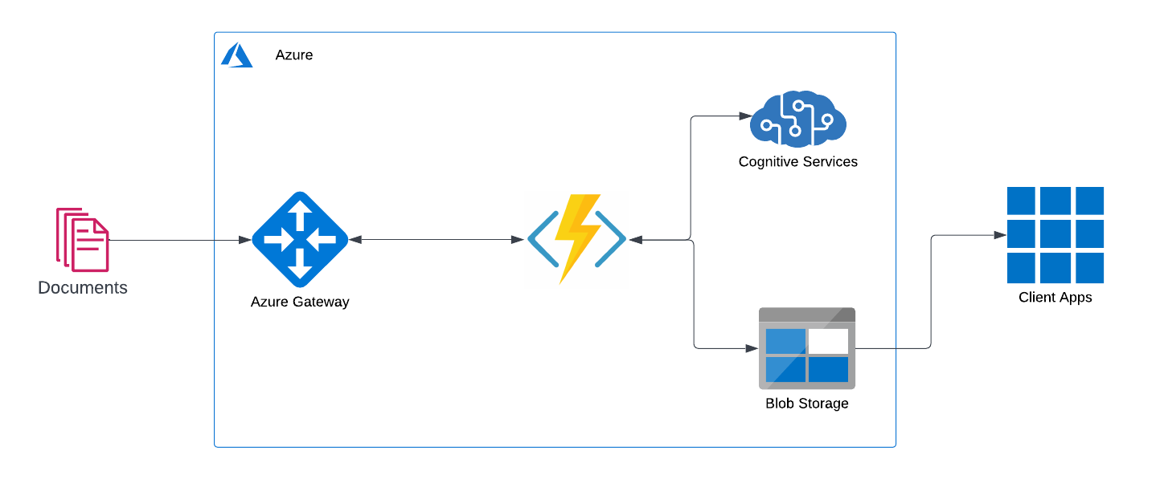

Slide 8
Tech Stack
3
Tools, Technology Stack (including the APIs consumed), and framework details

Slide 9
TECH STACK ANALYSIS
Tools
Python 3.9
APIs
Azure Functions
Azure Containers
Storage
Ghostscript
Poppler
Framework

Slide 10
Algorithms
4
The algorithms / machine learning models that have been used in the Hackathon prototype

Slide 11
USED Algorithms
numpy
opencv
Pillow
pdfCropMargins
imutils

Slide 12

A PICTURE IS WORTH A THOUSAND WORDS
A complex idea can be conveyed with just a single still image.
Namely making it possible to absorb large amounts of data quickly.

Slide 13
Output
5
Test cases and corresponding processed output file(s) along with the output time

Slide 14
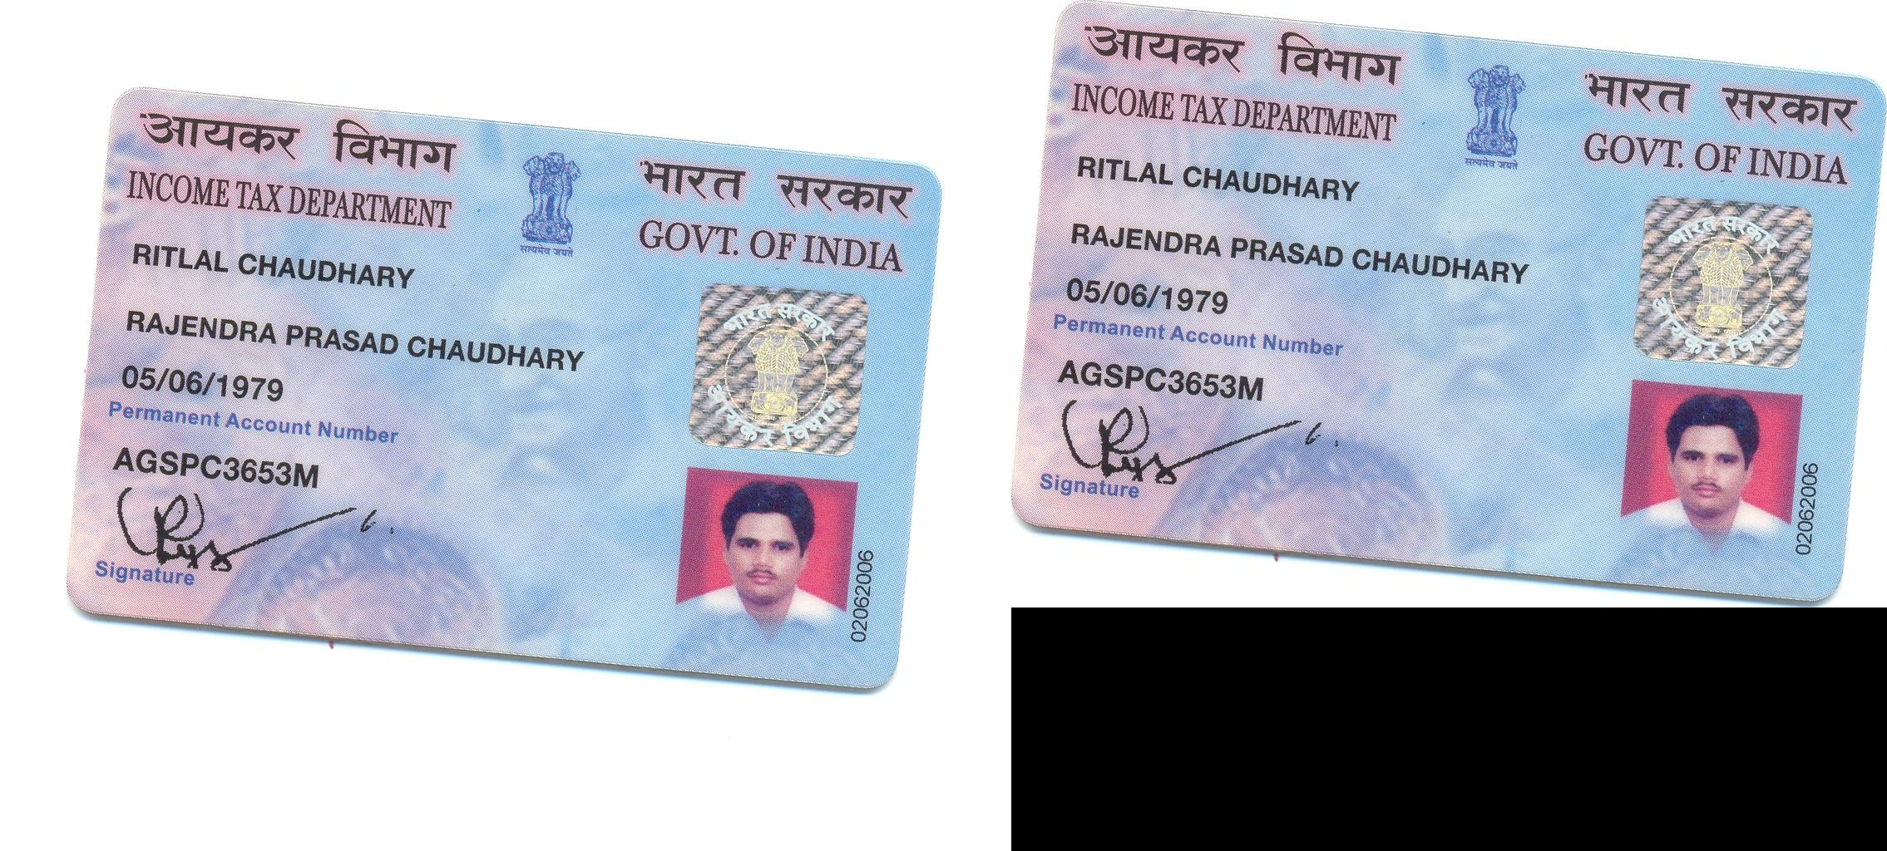
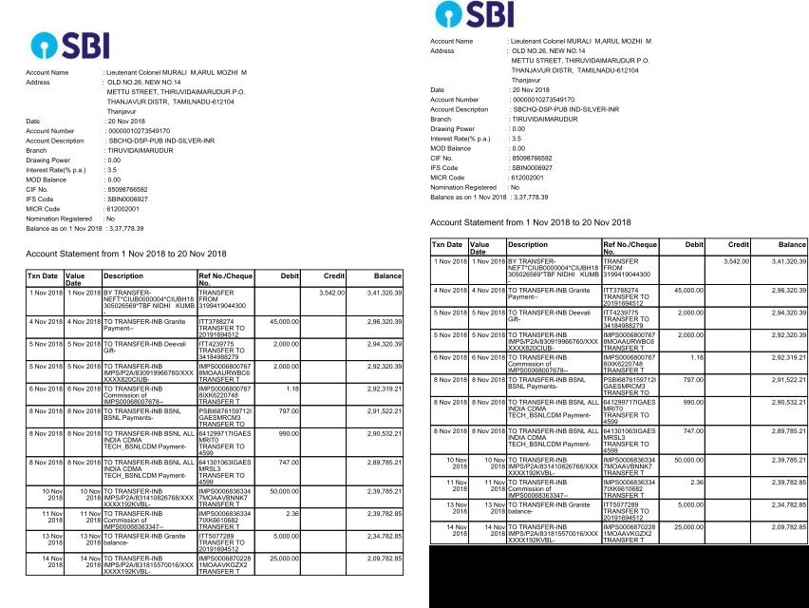
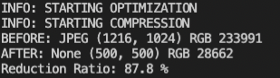
IMAGES

Slide 15
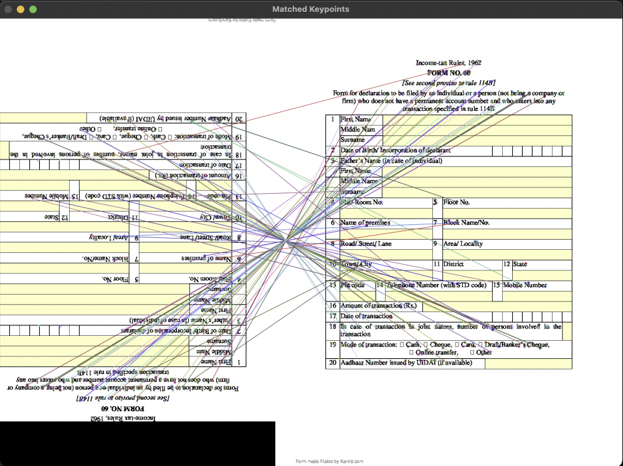
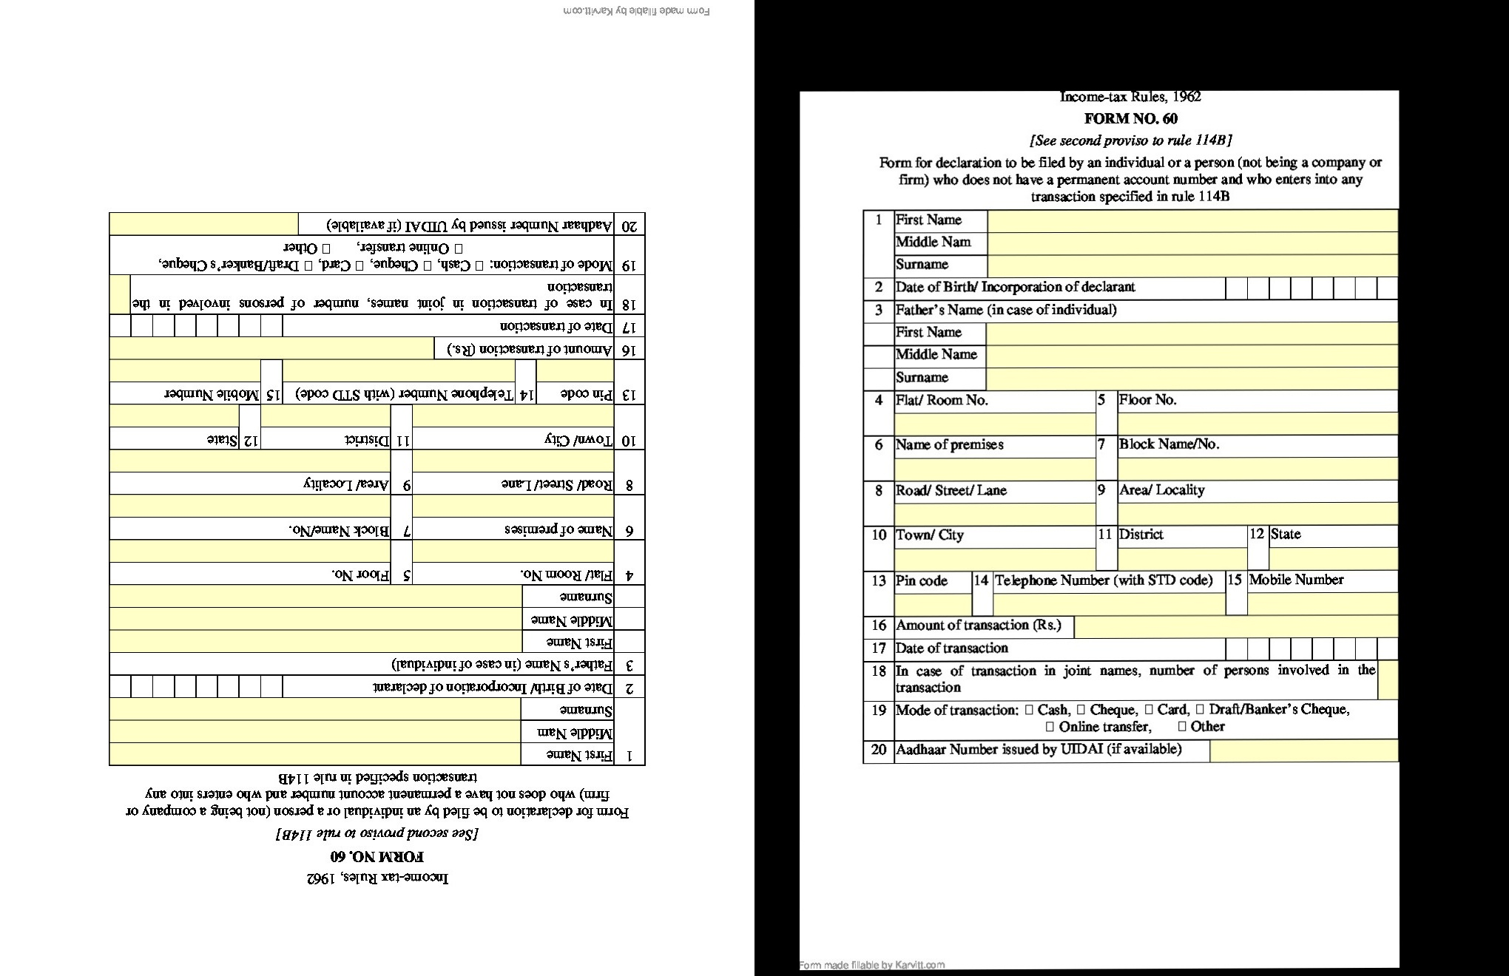
IMAGES

Slide 16
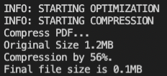
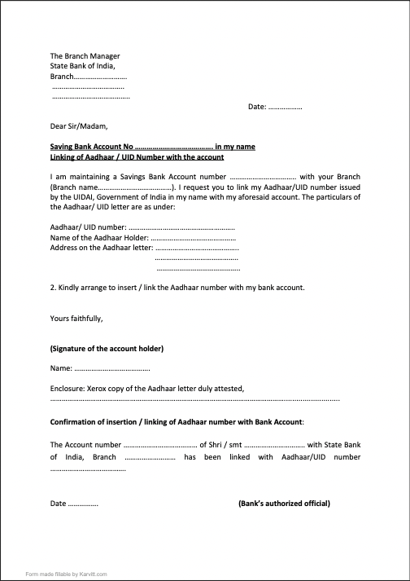
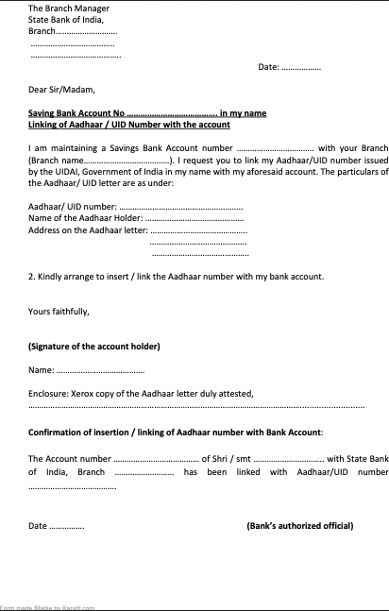
PDF DOCUMENTS

Slide 17
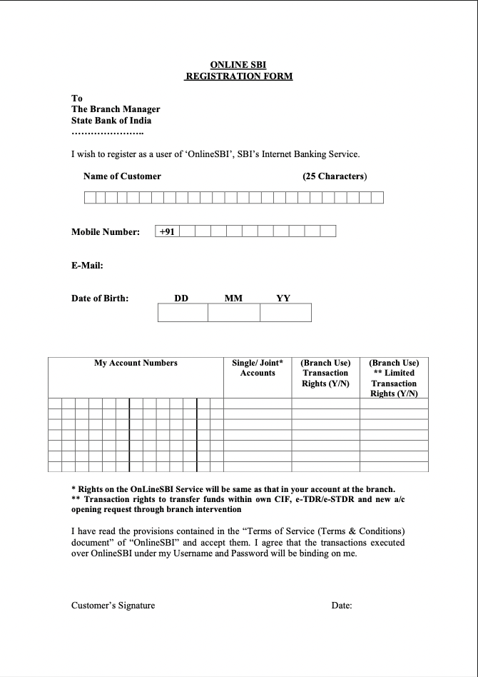
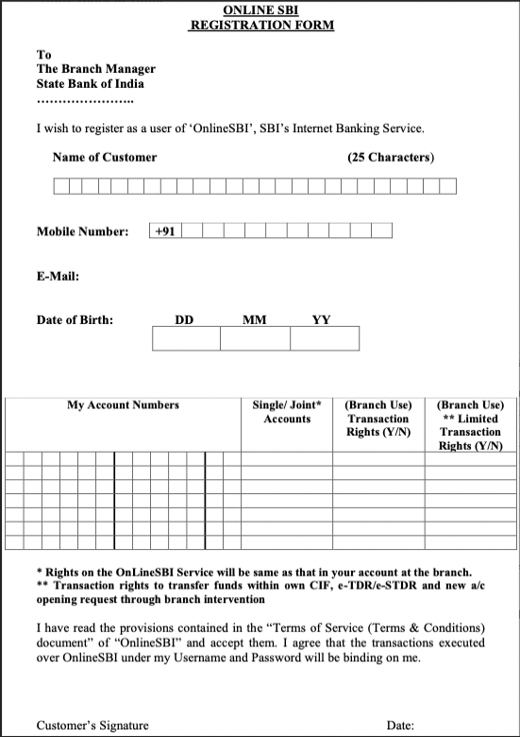
PDF DOCUMENTS

Slide 18
Summary
6
A write-up on why your application /solution should be considered

Slide 19
Why the solution should be considered?
The below points can be considered for my submission:
Works well for Both PDF and Images which contains noise.
No Special configuration required for pdf whitespace reduction and it optimizes well across samples.
Compression using Ghostscript is well proven within Industry and usage of it in the code works well across samples.
Image alignment using key feature matching algorithms generalizes well since we use a reference image for realignment.
Scaling the solution becomes easy as it can be easily deployed in an azure function which itself is a scalable solution.

Slide 20
Scaling
7
Ability to scale-up in enterprise grade environment

Slide 21
The Solution Can be dockerised and deployed as a HTTP Azure function
AZURE Functions
100% Scalable
That’s a easy serverless way of running the solution on cloud
instances of the Functions host are dynamically added and removed based on the number of incoming events.
Automatically scales based on demand using pre-warmed workers, which run applications with no delay after being idle, runs on more powerful instances, and connects to virtual networks
Total success!

Slide 22
Video Demo
Please Find the Link of the video here.

Slide 23
THANKS!
Any questions?
You can find me at
sourabh.kumar.janghel@outlook.com
@sourabhkumarjanghel

Slide 24
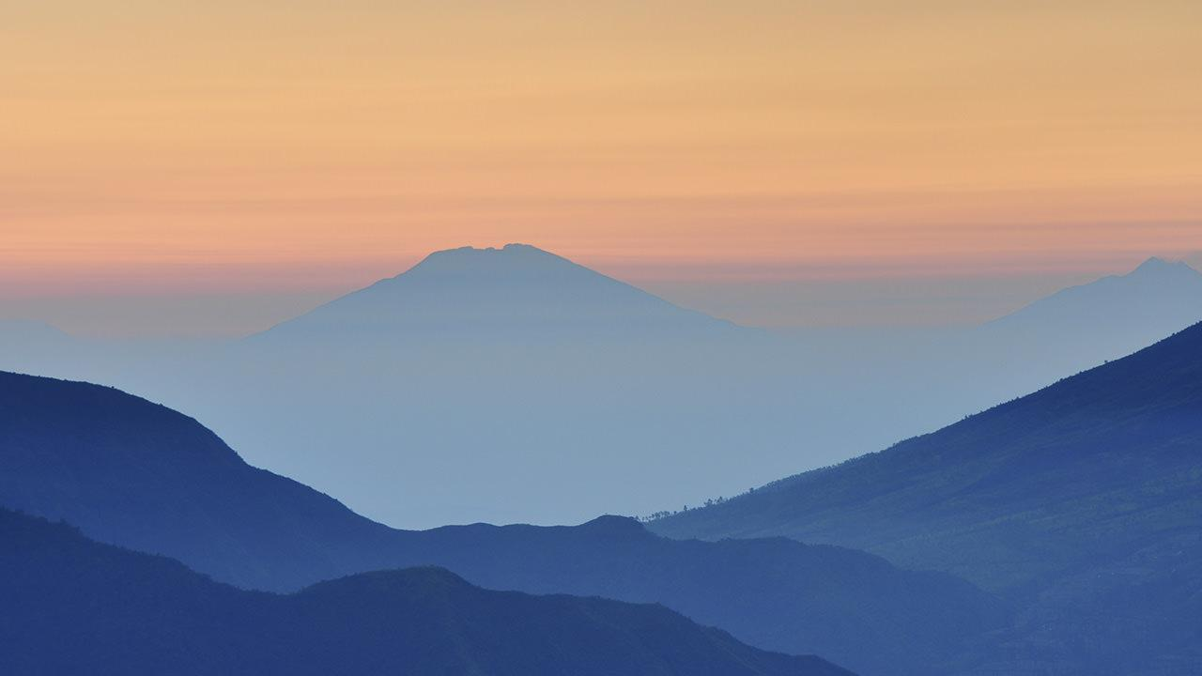
WANT BIG IMPACT?
USE AZURE CLOUD!

